Slide 1
My Life
By:Jake Ellis

Slide 2

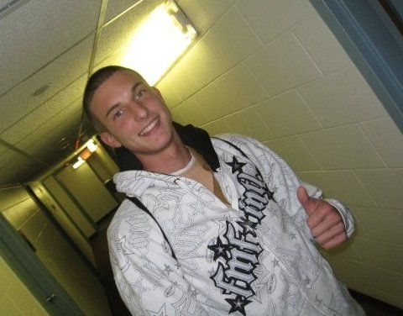
About me
I was born in England
6” 2”
I am 18 years old
Athletic

Slide 3

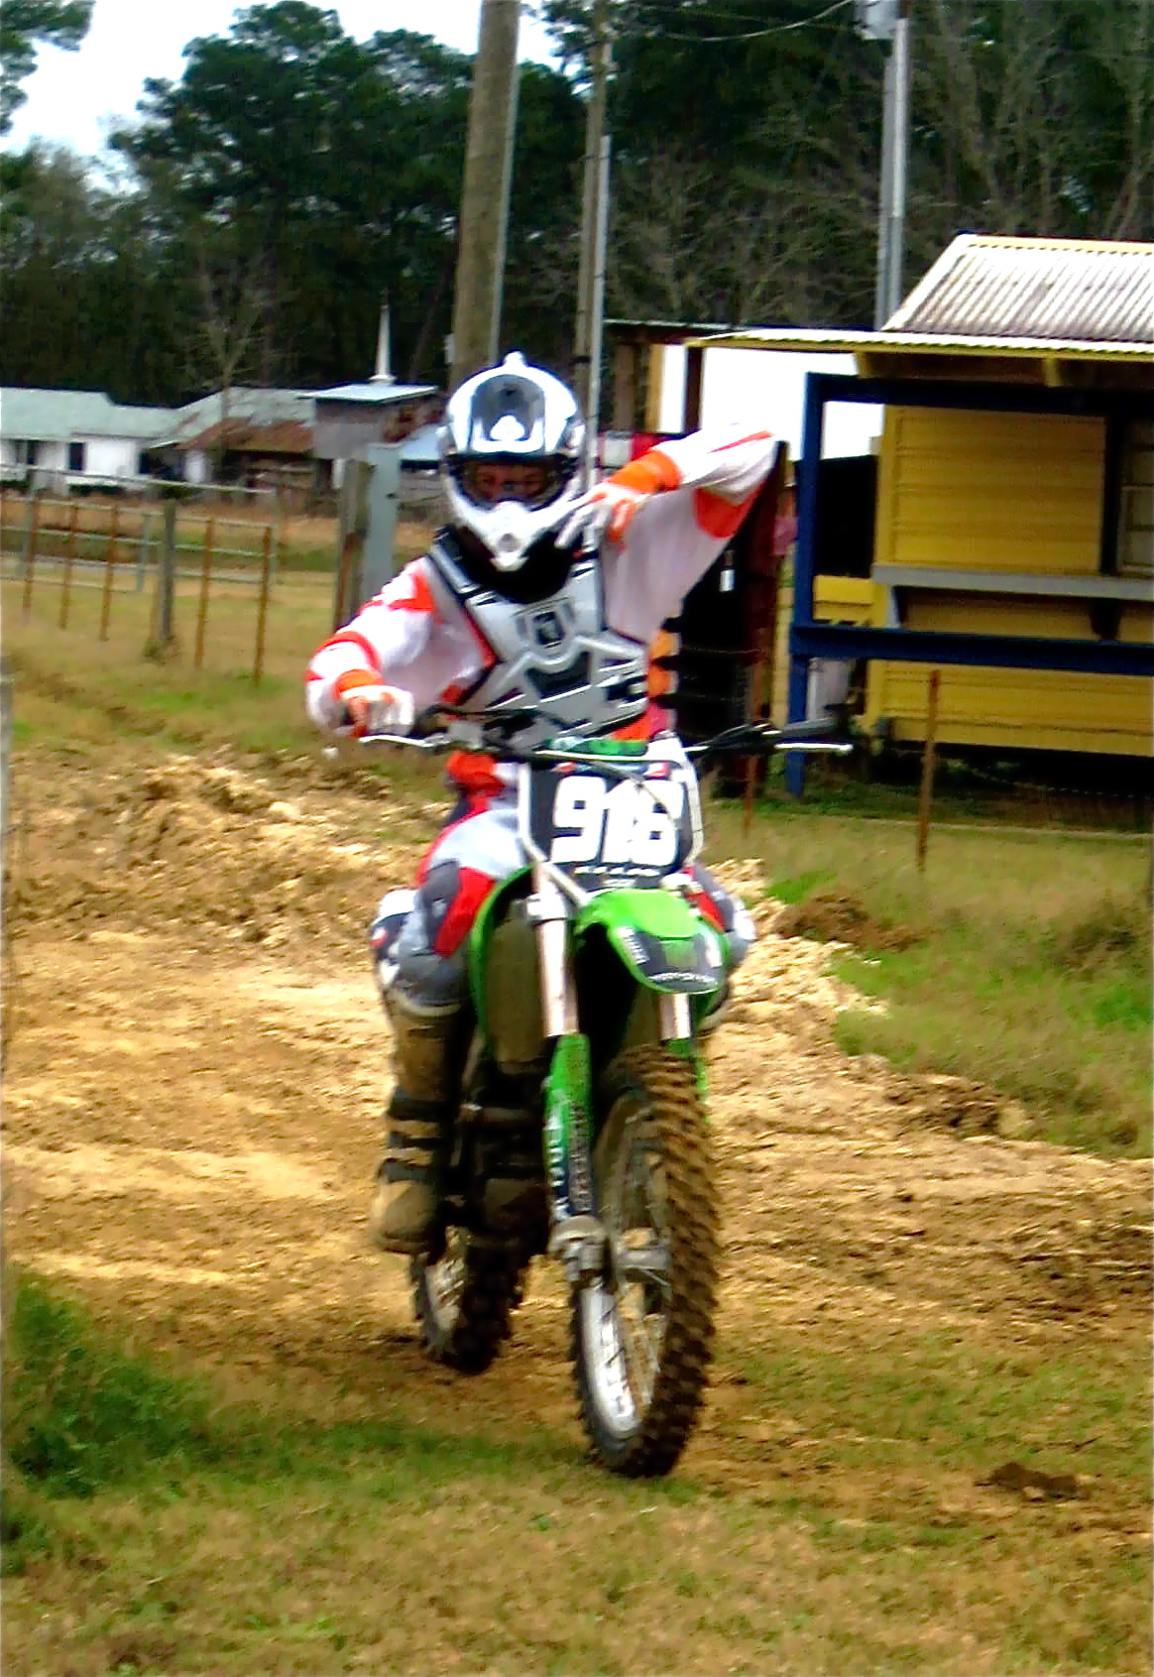
Hobbies
Motocross
Golf, basketball, softball, weight lifting
School work
Being with friends

Slide 4
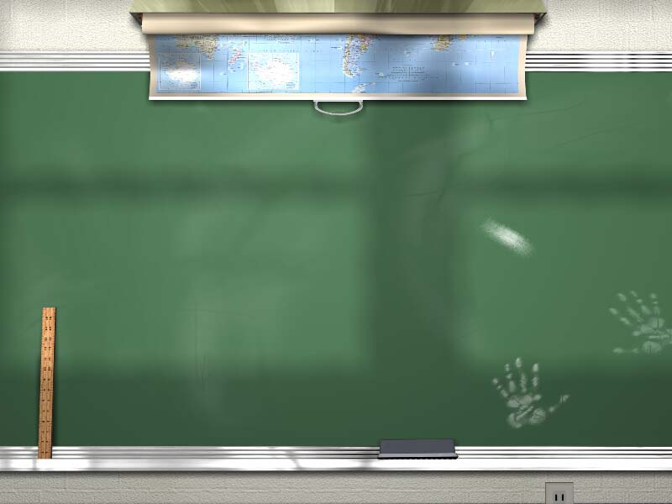
School
Erpenbeck Elementary School
Ockerman Middle School
Boone County High School
University of Louisville
  Freshman
  Business major

Slide 5
Family
I live with my mother and father
Two older siblings
  19 year old brother, whom also attends U of L
  23 year old sister
  2 dogs

Slide 6
Future
I plan on graduating U of L with a 3.0 GPA
Working for myself or opening my own business
Making a ton of money

